Slide 1


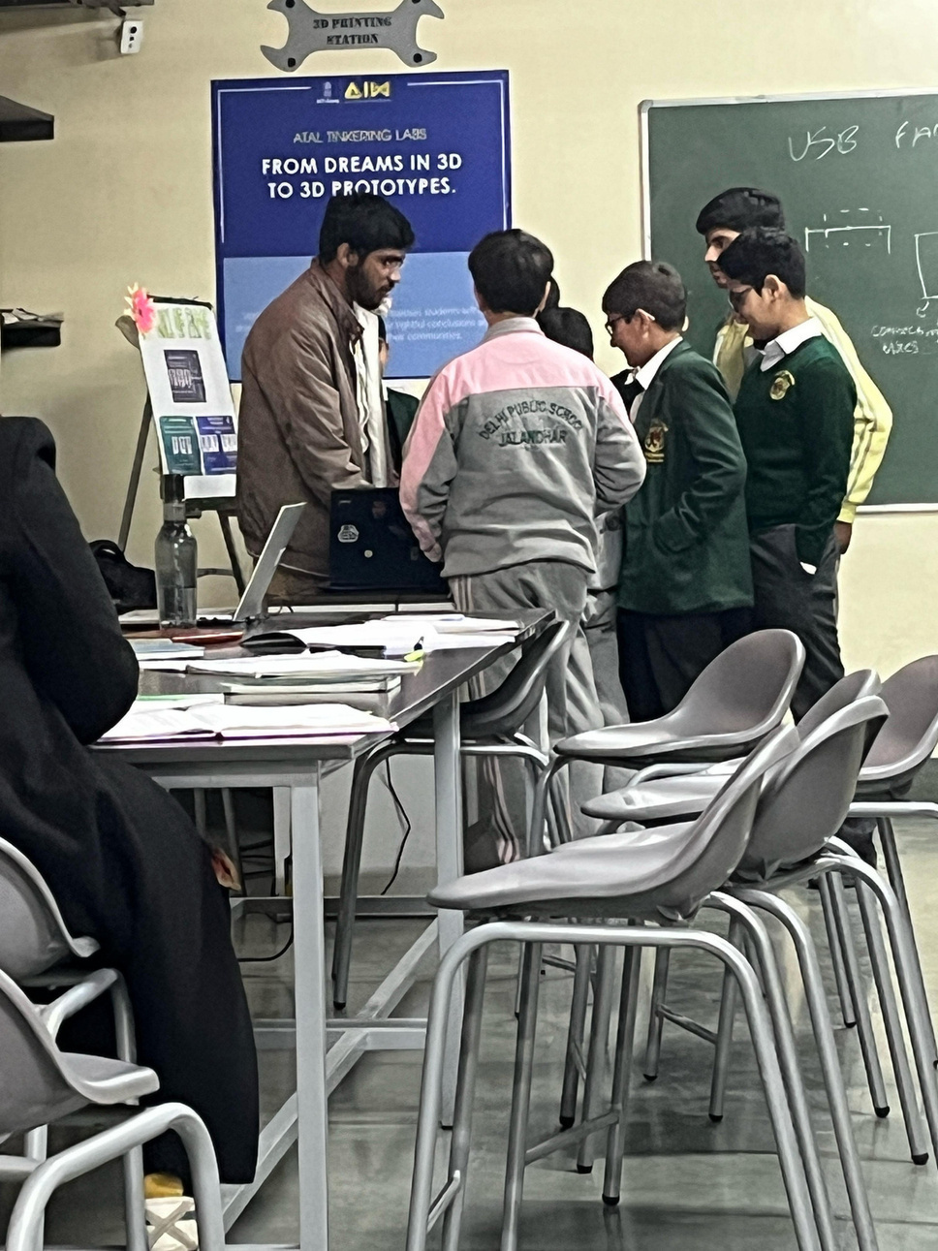

Quickfolks – Building the Foundation of Future Innovators
Hands-on Electronics | Competitive Robotics | Innovation Ecosystem
Empowering Students Through Practical Technology Education

Slide 2



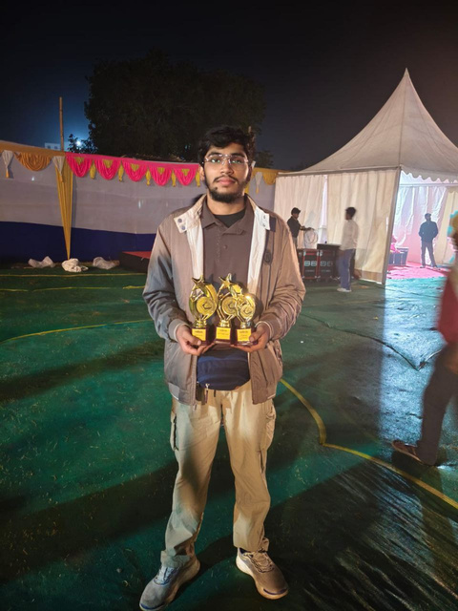

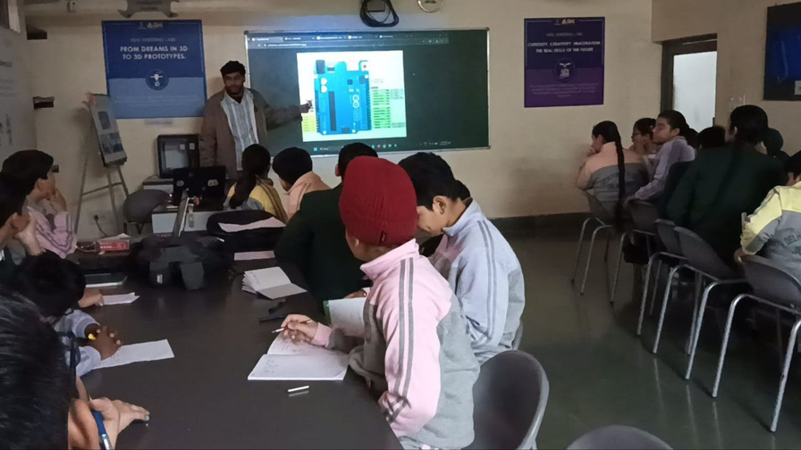
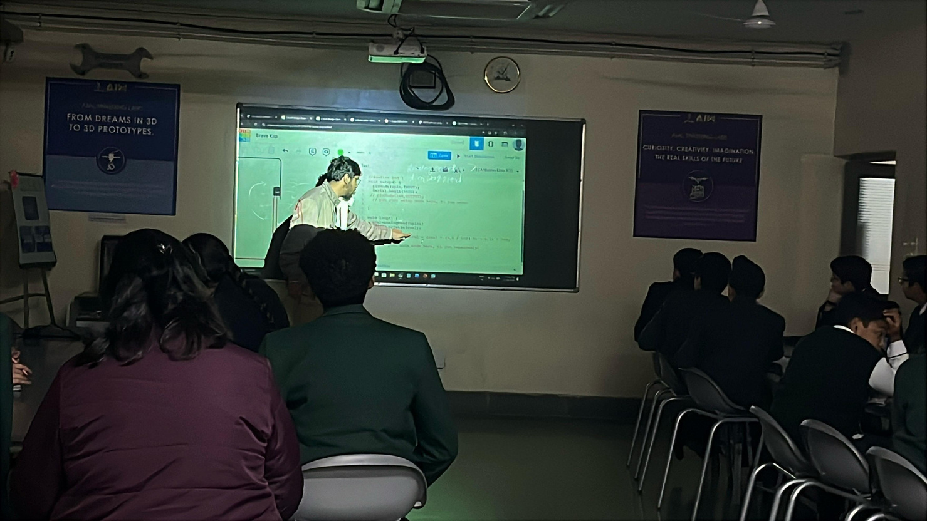


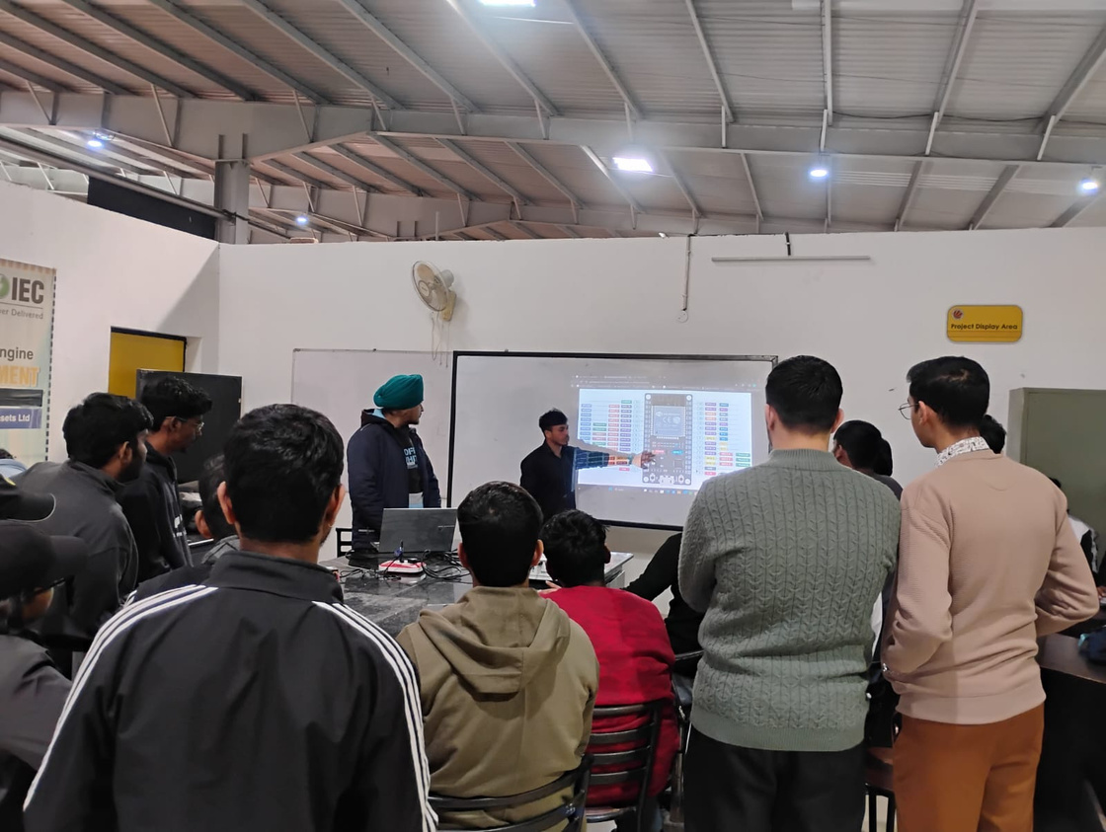
Let’s Explore
BRIDGING THE DREAM
& REALITY GAP
MOST SCHOOL STUDENTS ASPIRE ROBOTICS BY WATCHING DOREMON, AVENGERS, TRANSFORMERS, ETC. BUT THE REAL ROBOTICS IS A FAR CRY. AND WHEN STUDENTS REACH THE TIME TO LEARN ROBOTICS, THEY SAY IT'S TOO DIFFERENT AND WHY ECE.
WE WORK TO BRIDGE THIS GAP, TEACH STUDENTS ABOUT THE BASICS OF ECE AND ROBOTICS SO THEY DON'T QUIT WHEN IT'S THERE TIME

Slide 3

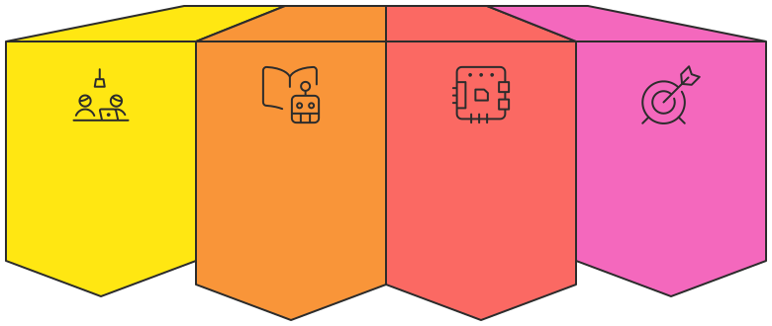
WHO WE ARE
About Quickfolks
Our Initiative
Student-Driven
Bridging the
Hands-On
Our Mission
Gap
Approach
Technology initiative
Build conﬁdent,
revolutionizing
Connects classroom
Transforms abstract
skilled, and
electronics and
theory with real-
concepts into
innovation-ready
robotics learning.
world application.
tangible skills.
students.

Slide 4
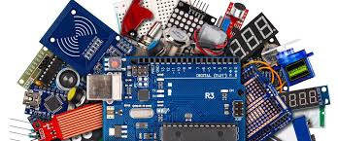
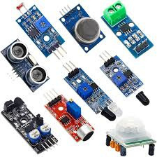
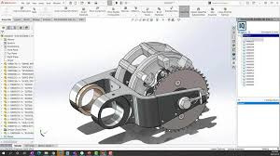
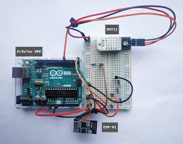
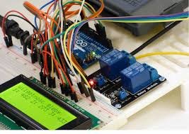
WORKSHOPS
Hands-On Electronics & ECE Workshops
Our comprehensive workshop series builds technical competency through practical, project-based learning. Students work with real components and professional simulation tools to master core engineering concepts.
Arduino & Microcontrollers
Sensors & IoT Projects
3D Design & CAD Modeling
PCB & Circuit Understanding
Renewable Energy Projects
Learn programming and circuit design through hands-on microcontroller projects
Build smart devices using real-world sensor technology and connectivity
Create and visualize engineering designs with professional modeling tools
Master the fundamentals of circuit design and board-level electronics
Explore sustainable technology through solar and alternative energy systems
✔ Structured Curriculum
✔ Age-Wise Modules
✔ Practical-First Approach
Progressive learning paths designed for mastery
Tailored content for Classes 6–12
Learn by building real projects

Slide 5

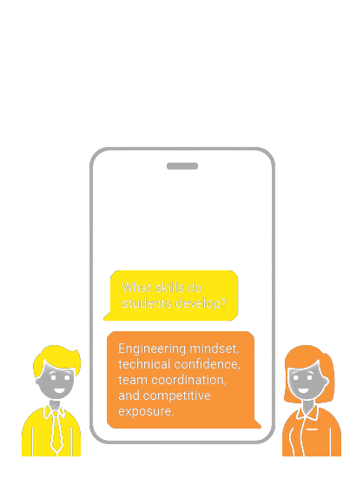

ROBOTICS TRAINING
Competitive Robotics & Technical Skill Development
Mechanical
Design
Learning structural
engineering and
optimization for
tournament
performance
Bot Driving Skills
Strategy &
& Control
Teamwork
Developing precise
Building collaborative
control techniques for
problem-solving skills
competitive
and competitive game
environments
strategies
Robot Building
Competition
Fundamentals
Training
Mastering mechanical
Robo Soccer, Robo
construction and
Race, and Robo Wars
electronics integration
preparation with
Competitive
tournament simulation
Robotics

Slide 6





EVENTS & CULTURE
Building a Competitive & Innovation Culture
1
Robotics
Competitions
From Study to Embodiment
Host regional
tournaments to bring
together young minds.
2
Tech Fests
Organize celebration
events showcasing
student innovation and
projects.
3
Hackathons &
Challenges
Active Integration
Applying technology in
daily life
Technical
Excellence
Mastering technology
skills and knowledge
Run intensive problem-
solving events and
innovation
competitions.

Slide 7
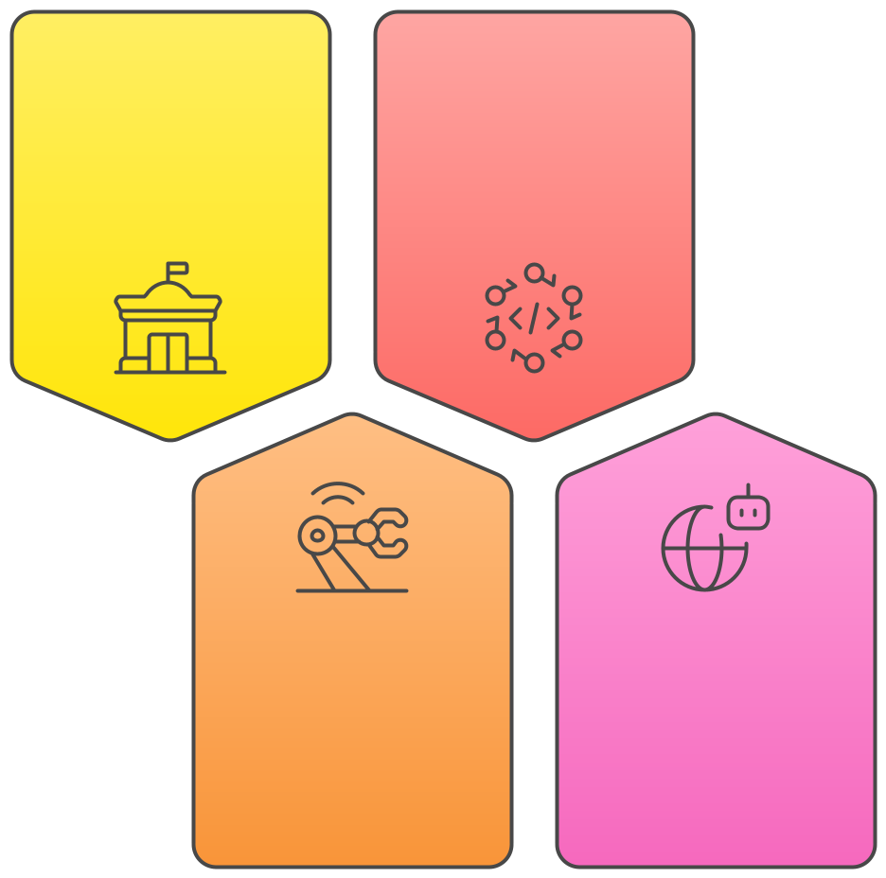

GLOBAL EXPOSURE
Beyond the Classroom – Real World Exposure
Competition Mentorship
We believe true learning happens when students test their skills against the best. That's why we don't just train students—we take them to compete on national and international stages.
Hackathons
Student Mentorship Process
IIT Tech Fests
Solve real-world
Compete at India's
problems in
Team
premier technical
intensive coding
Formation
institutions.
events.
Technical
Guidance
Prepared and
Student Entry
Competitive
Students
Personal
National
World Robotics
Mentoring
Robotics
Championships
Strategy
Championships
Represent on the
Development
Face off against top
global stage.
We don't just train students. We take them to compete.
teams nationwide.

Slide 8

WHY QUICKFOLKS
Beneﬁts of Quick Folks Program
Innovation
Competition
Culture
Exposure
Fostering creativity
Opportunities to
and technical
compete nationally
excellence
and internationally
Technical
Hands-On
Foundation
Learning
Expertise in
Practical skills with
electronics and
real components
robotics for
and projects
engineering careers
Long-Term
Structured
Development
Curriculum
Building conﬁdent
Comprehensive
and capable
learning from basics
innovators
to advanced topics
Let's build the future innovators together.

Slide 9
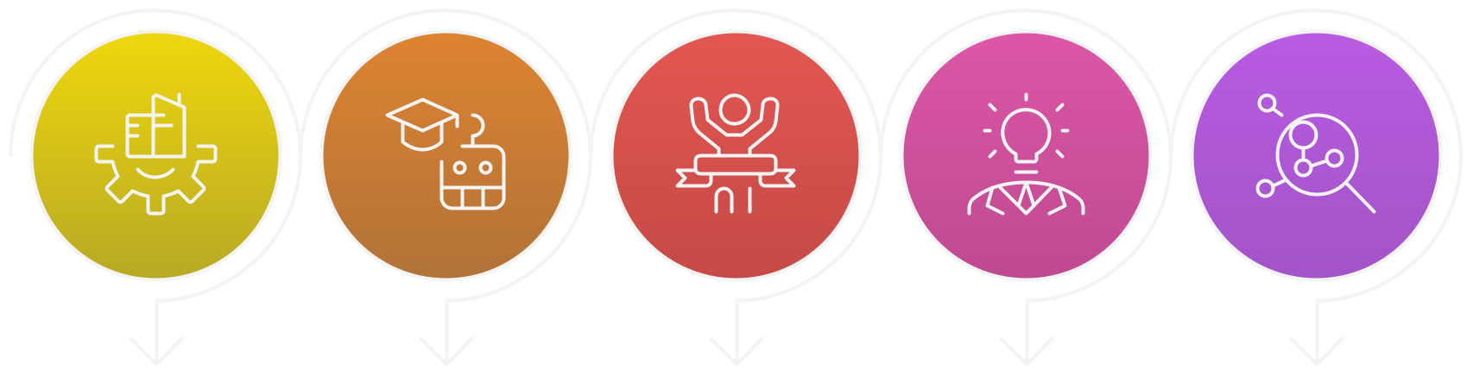
OUR VISION
Building the Foundation of Future Innovators
At Quickfolks, our vision is to create a strong technical ecosystem within schools where students:
Beneﬁts of Electronics & Robotics Education
Solid
Practical
Competitive
Innovation &
Problem-
Foundation
Experience
Edge
Creativity
Solving
Develop core strong
Learn through
Build conﬁdence to
Transform curiosity
Move beyond theory
foundation in
hands-on projects
excel at national and
into tangible
to become real-
Electronics &
and real-world
international levels.
innovations and
world problem-
Robotics.
application.
solutions.
solvers.
We aim to empower young minds with the skills, exposure, and mindset required for the future of technology.

Slide 10



ACHIEVEMENTS
Tech Fest
      1st – Robo Soccer (IIT PATNA ‘26)
      3rd – Robo Race (IIT PATNA ‘26)
      Competed against teams from Nepal and multiple Indian institutions
      3rd – pick and place (IIT ROPAR ‘26)
      3rd – Robo Hockey (World Robotics Championship ‘25)
      1st - Robo Soccer - (LPU ‘25)
Hackathon
Students mentored
      Selected in Waitlist Round (SIH)
      2nd - PGSC Innotech 26
      Mentored 200+ students and more with time
Proven excellence in national and international robotics competitions.

Slide 11
CONTACT US
Let’s Build the Future Together
Quickfolks – Technology & Robotics Initiative
We are looking for partners for:
      Workshop Collaborations
      School Tech Fests
      Robotics Training
      Competition Mentorship
📧 Email: quickfolks.help@gmail.com
📱 Contact: +91 7318449629
🌐 Website: quickfolks.com
Partner with us to create a culture of innovation in your institution.

